Slide 1






Bonrix Embedded Innovations: Pioneering the Future of IoT and Embedded Systems
Where Innovation Meets Excellence
IoT Systems
Embedded Systems
AI/ML Integration
PCB Design

Slide 2






Company Overview
Specializes in Embedded Electronics Products tailored to diverse business requirements
Expertise in innovation, design, and manufacturing
Comprehensive services in AI/ML and IoT firmware development, as well as enclosure engineering
Mission: Empower businesses with innovative technology solutions that set them apart in the digital landscape
Based in Ahmedabad, Gujarat, India

Slide 3




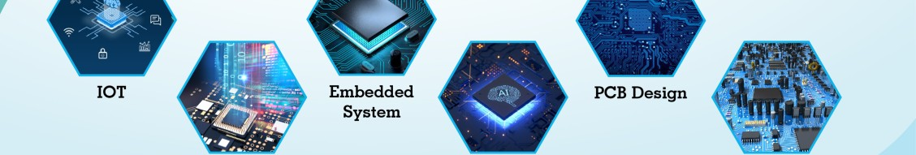



Core Services
IoT Systems
Firmware Development
Embedded Systems
Embedded AI/ML
PCB Design
Electronics Components
IoT/Electronics Enclosures

Slide 4


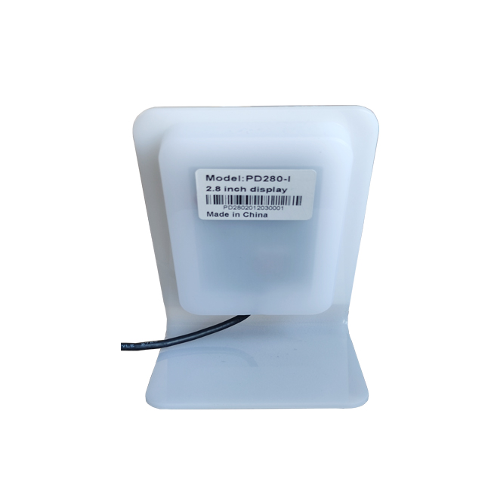






Product Categories
Digital QR Soundbox (DQR-222)
7 Inch Smart Retail Display
USB, WiFi, Bluetooth and Digital Signage models
USB and WiFi models with dynamic QR code
QR Scanner Display (DQR-111)
USB Dynamic QR Display
Various enclosure options for different needs
USB-Serial, Image, WiFi and Bluetooth models
WiFi Dynamic QR Display
Bluetooth Dynamic QR Display
Multiple enclosure designs for flexibility
Various enclosure options with connectivity
Binary Image Display
Image Rotation Display
Compressed image display with multiple enclosures
3.5 inch display with rotation capability

Slide 5


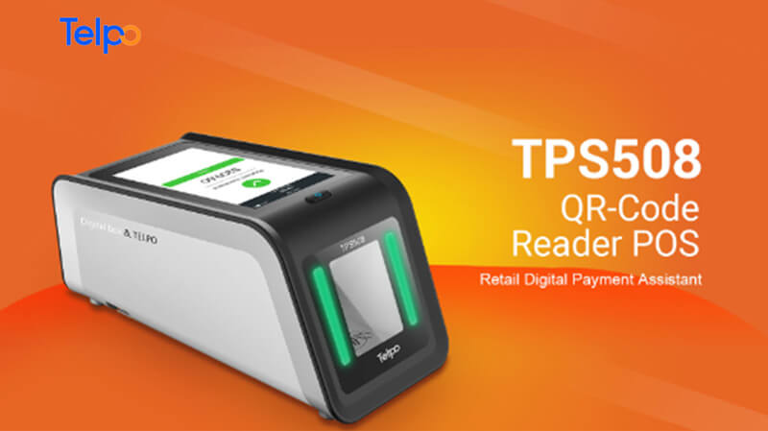




Key Product Features
Dynamic QR Code
Multiple Connectivity
Real-time updates for various applications
USB, WiFi, Bluetooth and Image-based models
Soundbox Integration
Various Display Sizes
Audio feedback for payment confirmations
From 3.5 inch to 7 inch displays
Custom Enclosures
Versatile Applications
ABS, Acrylic, PLA plastic options
Retail payments, digital signage, and more

Slide 6







Benefits of Our Solutions
Customized Solutions
Cutting-Edge Technology
Products tailored to specific business needs
AI/ML integration with embedded systems
Enhanced Efficiency
Real-Time Data Access
Streamlined business processes with IoT
Improved decision-making with connected systems
Cost-Effective
Reliable Performance
High-quality products at competitive prices
Durable and dependable solutions

Slide 7



Contact Us
Address
A-701 Dev Aurum Commercial Nr. Anand Nagar Cross Road Prahlad Nagar, Satellite Ahmedabad, Gujarat 380015 India
Phone
+91-9409745500
Where Innovation Meets Excellence
Websites
embeddedinnovations.in embedded-innovations.co.in embedded-innovation.co.in

